Slide 1
Angular Testing
5 - Component Tests Advanced
Notes:
Schwerer wirds nicht, dafür kann RxJS auch einiges
Komplexe RxJS kann aber nur mit Unit Tests testen
Man muss direkt an die Observables rankommen. Private Methoden oder so gehen nicht

Slide 2
Mocking Components
"Three Monkeys"
Component Stubs
ng-mocks
Don't mock!

Slide 3

Mocking Components - Three Monkeys
it('should mock components in 🙊🙉🙈 style, () => { const fixture = TestBed.configureTestingModule({ declarations: [RequestInfoComponent], schemas: [NO_ERRORS_SCHEMA] }).createComponent(RequestInfoComponent); fixture.detectChanges(); expect(true).toBe(true); });

Slide 4
Mocking Components - Manually
it('should stub the components', () => { @Component({ selector: 'mat-form-field', template: '' }) class MatFormField {} const fixture = TestBed.configureTestingModule({ declarations: [RequestInfoComponent, MatFormField], imports: [ReactiveFormsModule] }).createComponent(RequestInfoComponent); fixture.detectChanges(); expect(true).toBe(true); });

Slide 5
Mocking Components - ng-mocks
it('should stub the components', () => { const fixture = TestBed.configureTestingModule({ declarations: [RequestInfoComponent, MockComponent(MatFormField)], imports: [ReactiveFormsModule] }).createComponent(RequestInfoComponent); fixture.detectChanges(); expect(true).toBe(true); });

Slide 6
Mocking Components - Don't
it('should import the modules', () => { const fixture = TestBed.configureTestingModule({ declarations: [RequestInfoComponent], imports: [ReactiveFormsModule, MatFormFieldModule, MatHintModule, MatLabelModule] }).createComponent(RequestInfoComponent); fixture.detectChanges(); expect(true).toBe(true); });
Notes:
If you require rendering of these nested components, it is fine.
Can cause problems when they again contain nested components

Slide 7

Reducing Boilerplate

Slide 8

Test Setup
Notes:
Vor allem für komplexe Datenstrukturen
Object Mothers
Dazusagen, dass es auch die Möglichkeit für Verschachtelungen gibt

Slide 9
Approaches
beforeEach
Default Configuration by Angular CLI
All tests with same setup
Simple situations
Nested describes, aka. Contexts
Advanced Scenarios
Limited amount of TestBed configuration
Factory methods
The test has full control - not the Test Suite
Most Flexible

Slide 10


Popular Libraries
Testing Library

Slide 11

Harnesses
Taming the Beast...

Slide 12
Test Harnesses
Page Object Models for Component Tests
Available since Angular v9
Provide a test abstraction for components
Developed by @angular/material
Full coverage for material since v11
Reduces code size significantly
Better Readability
Better Maintainability

Slide 13

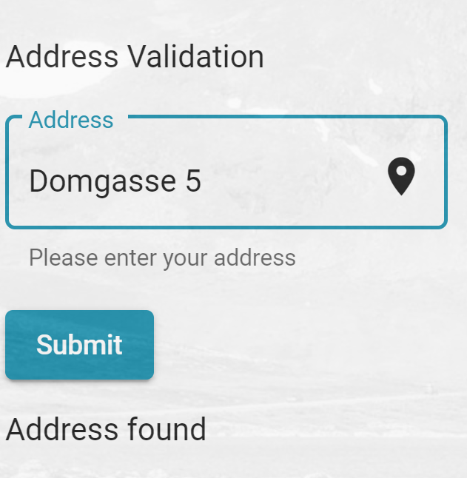

Slide 14
Harness
Element Selection
Change Detection
Asynchronity
Rendering

Slide 15
Creating a Harness
export class RequestInfoComponentHarness extends ComponentHarness { static hostSelector = "app-request-info"; protected getButton = this.locatorFor("button[type=submit]"); async submit(): Promise<void> { const button = await this.getButton(); return button.click(); } }

Slide 16
Using a Harness
it("should use the harness", async () => { // setup TestModule… const harness = await TestbedHarnessEnvironment.harnessForFixture( fixture, RequestInfoComponentHarness ); await harness.submit(); // expect something });

Slide 17

Lab Time

